Slide 1
the video games Industry--taking the Genshin Impact as an example
Xinyi Xu
Ziyue Qin
20241118 Gao Si Li Chen Capturing the Baijiu Industry Landscape.key

Slide 2
Outlines
1. Motivations
2. Word Clouds
2.1 Word Cloud from Tang Poetry
2.2 Word Cloud from Baijiu Industry Reports
3. Topic Modeling with LDA
4. Interactive Graphs of Stock Prices
5. UMAP Analysis of Indices
6. Minimum Spanning Trees (MST)
6.1 Example 1: Time Series Segmentation
6.2 Example 2: Distance Between Stocks
7. SVM
8. Conclusion

Slide 3


Digital Economy
Motivation
Genshin impact is a world-wide popular 3D video game, which is a leader of Chinese games.
Why Choose the video games Industry
Emerging industries
Some of the games have good revenues

Slide 4
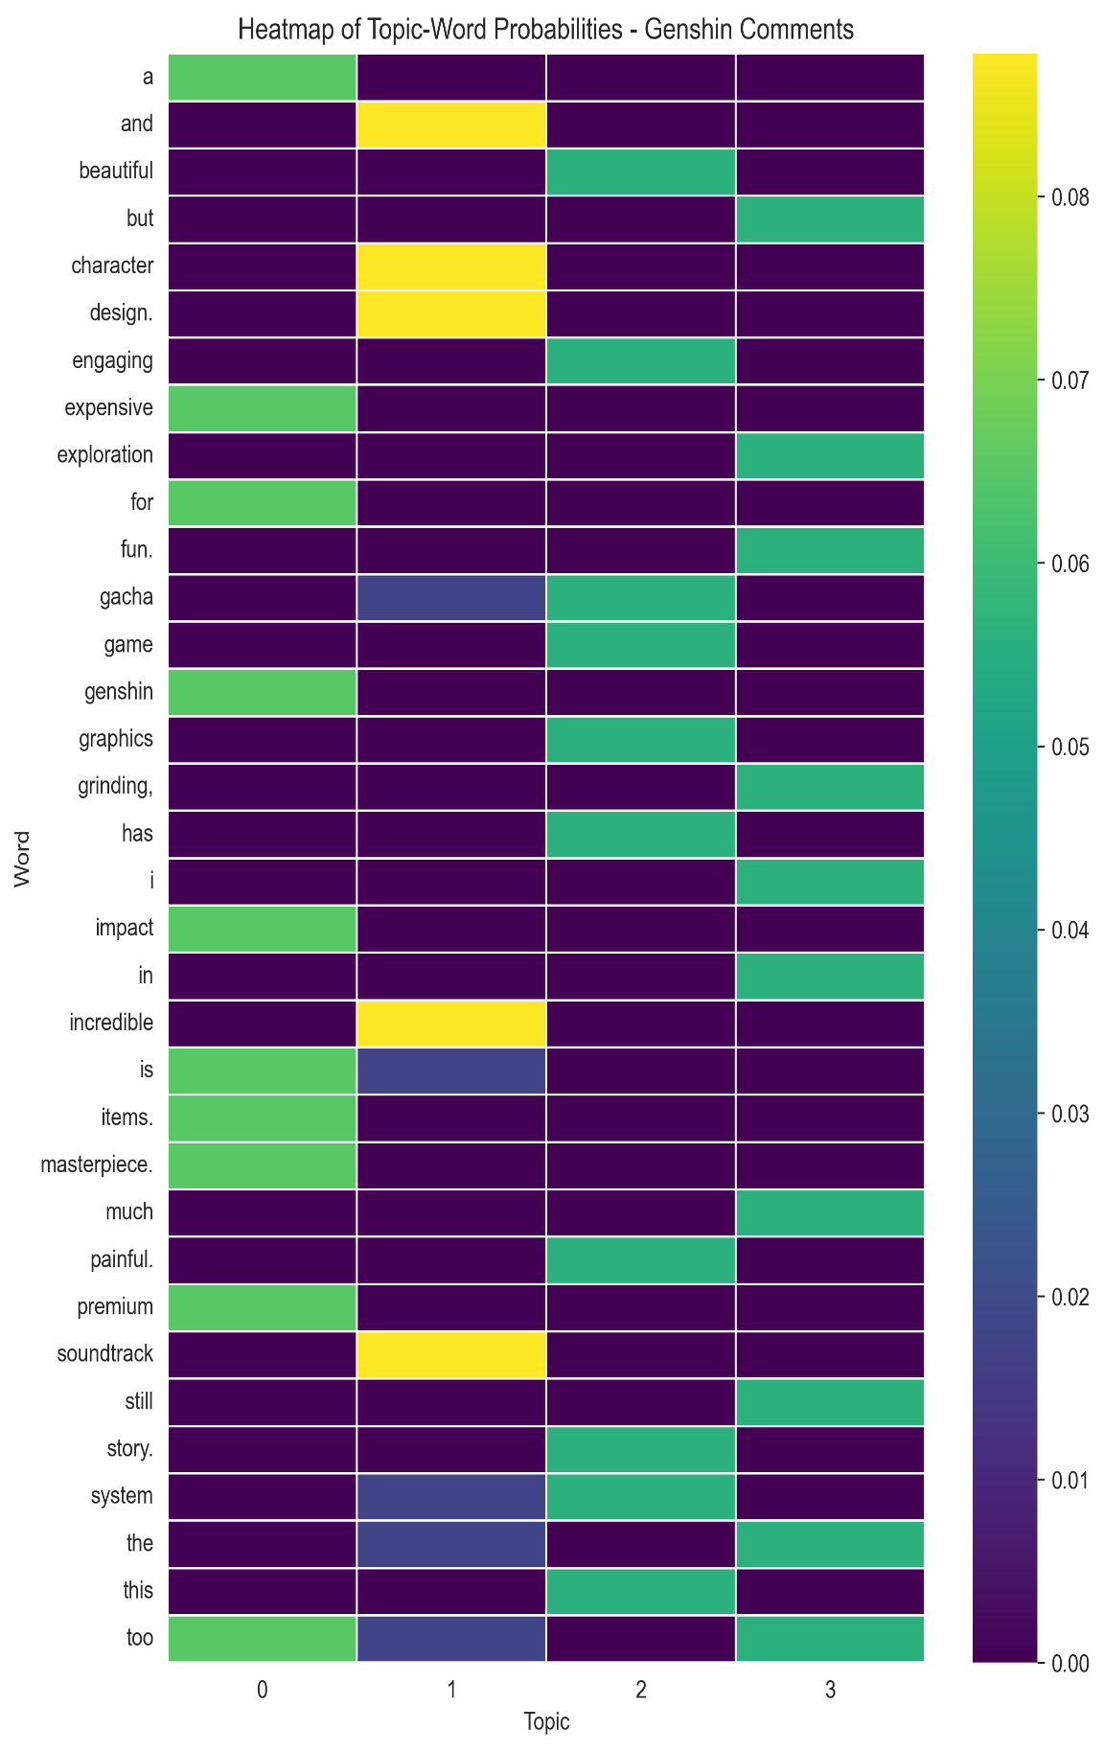

Heatmap of Topic-word Probabilities
Topic Modeling with LDA
2025 Genshin impact‘s comment
7 topics
Train LDA model using gensim
The heatmap with keywords and topics.

Slide 5
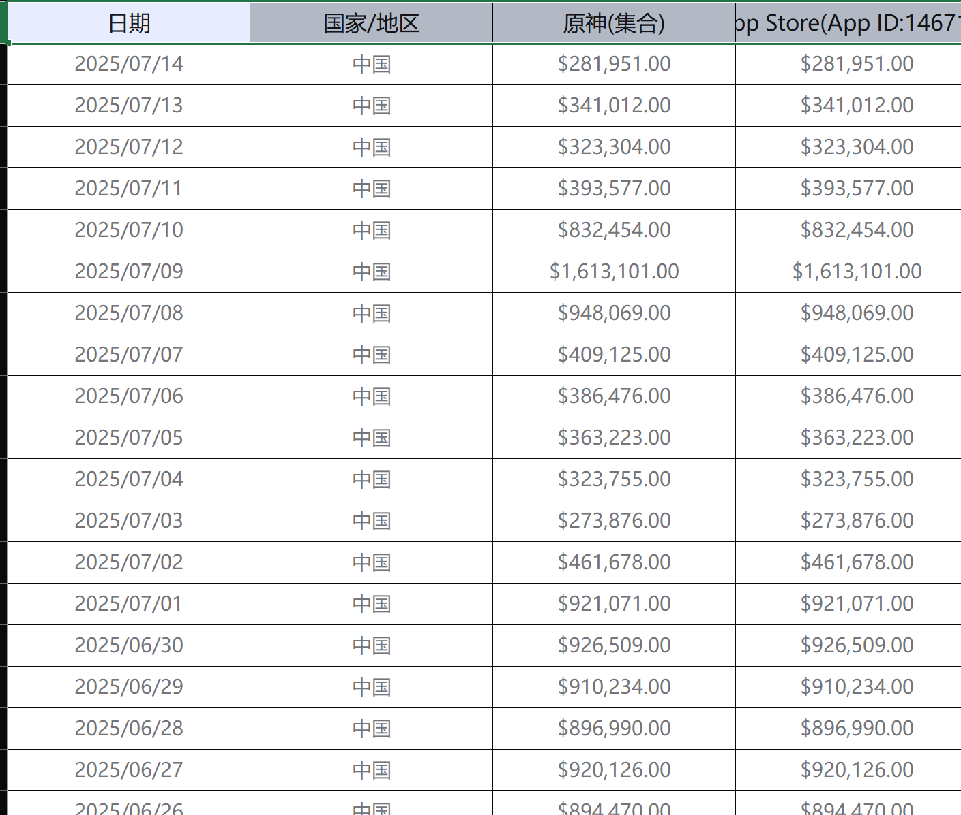
Data
Data and Descriptive Statistics
Get income data of Baijiu industry from 2023-09-28 to 2025-07-14
China
A lot of data is omitted here

Slide 6
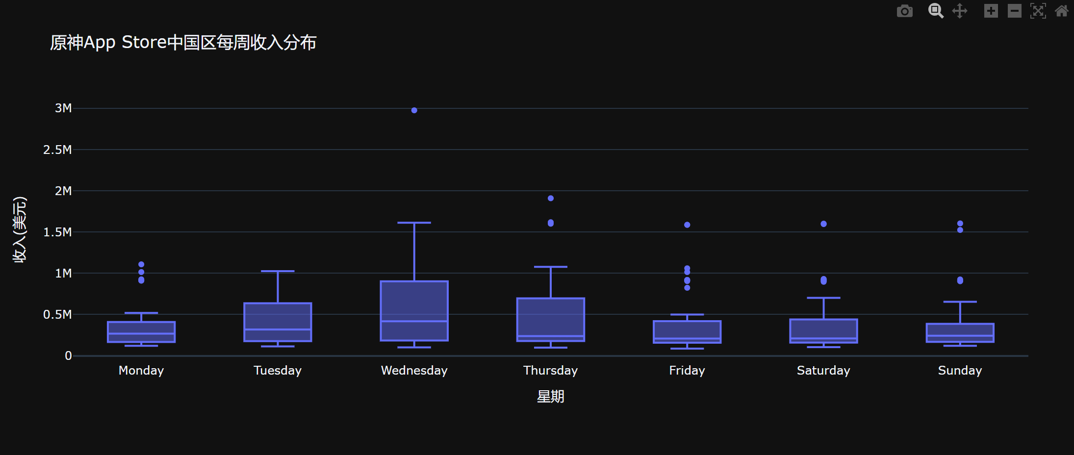
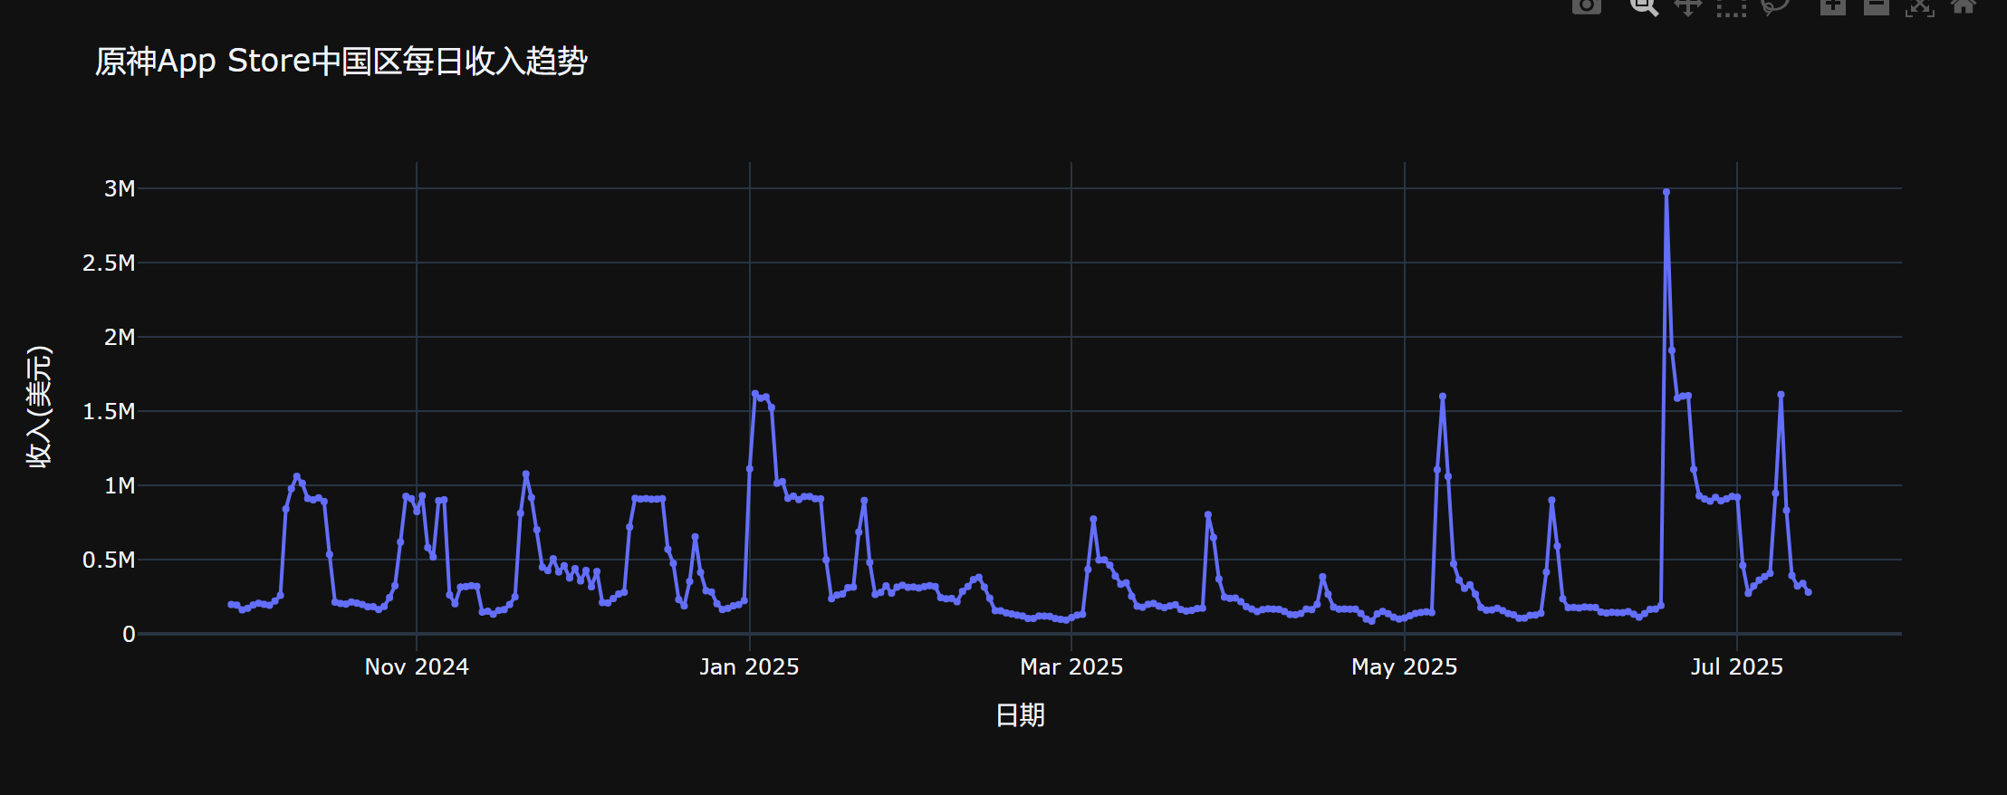
Interactive Visualisations
Data and Descriptive Statistics
Interactive Visualisations of the income Genshin impact(原神)
Sort the data by date
Plot graph

Slide 7
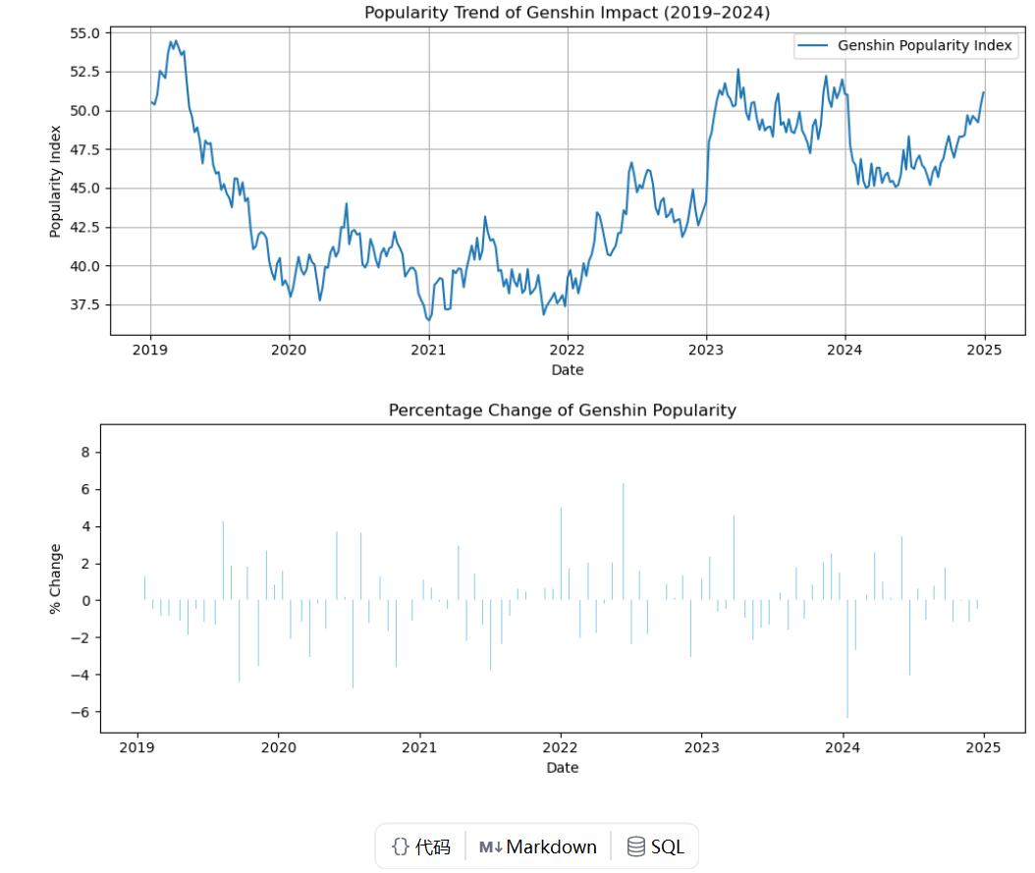
Genshin Impact's popularity data from 2019 to 2024 Heat trend and daily percentage change
Data and Descriptive Statistics

Slide 8
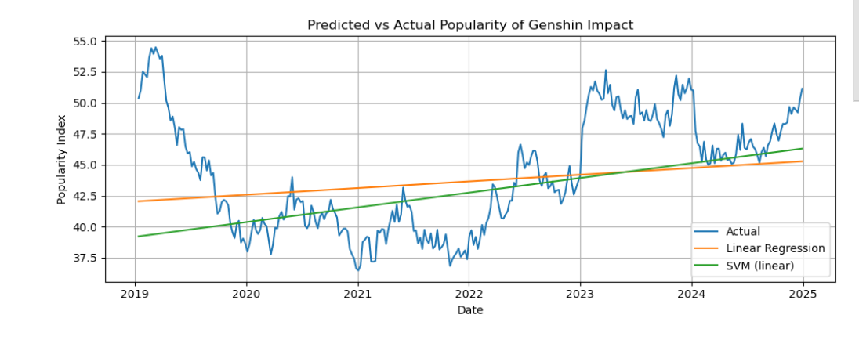
Forecast comparison chart
Data and Descriptive Statistics

Slide 9
UMAP
UMAP
The income data creates a high dimensional feature space
open, high, low, close, volume, etc.
UMAP for dimensionality reduction
Preserving Global Structure
Improved Interpretation
To uncover hidden patterns and relationships between stocks that might be obscured in the original high-dimensional space.

Slide 10
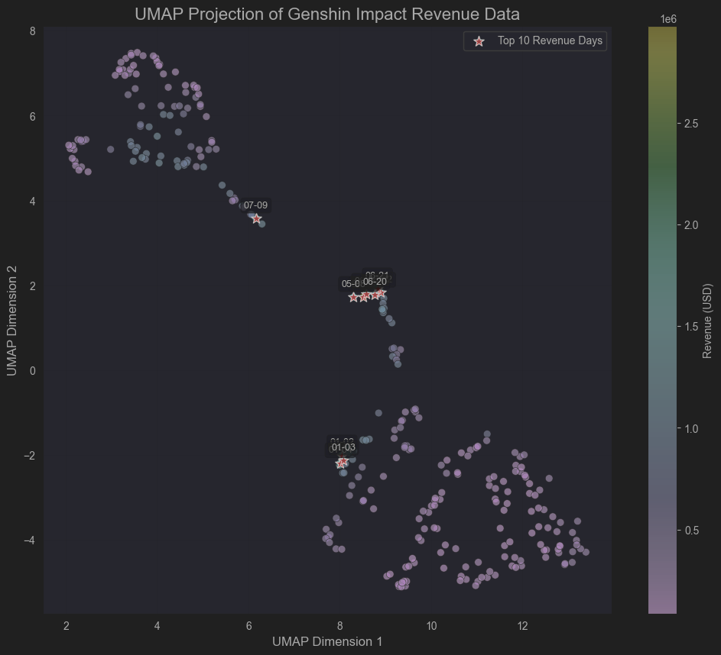
UMAP Dimensionality Reduction
UMAP
Using UMAP before clustering will likely lead to more interpretable results than applying a clustering algorithm directly to the raw, high-dimensional data.

Slide 11
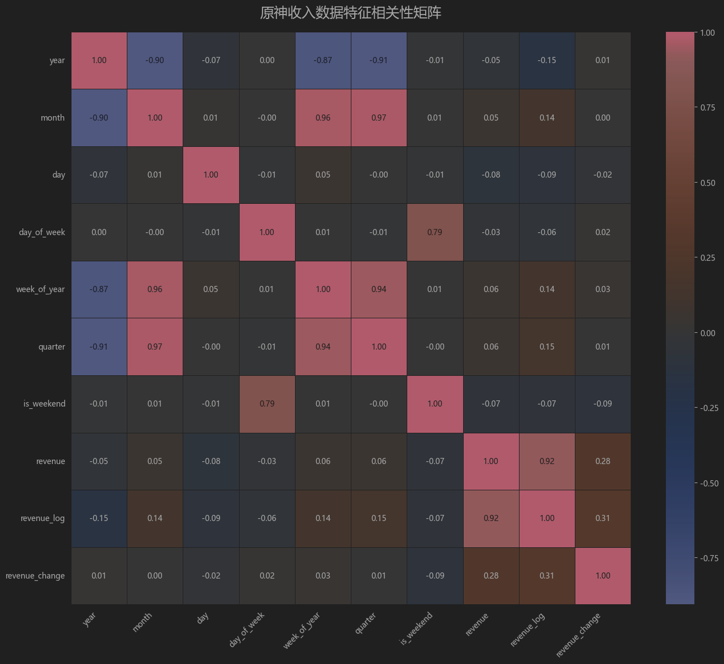
Heatmap of correlation matrix
Minimum Spanning Trees within Stocks
Using UMAP before clustering will likely lead to more interpretable results than applying a clustering algorithm directly to the raw, high-dimensional data.

Slide 12
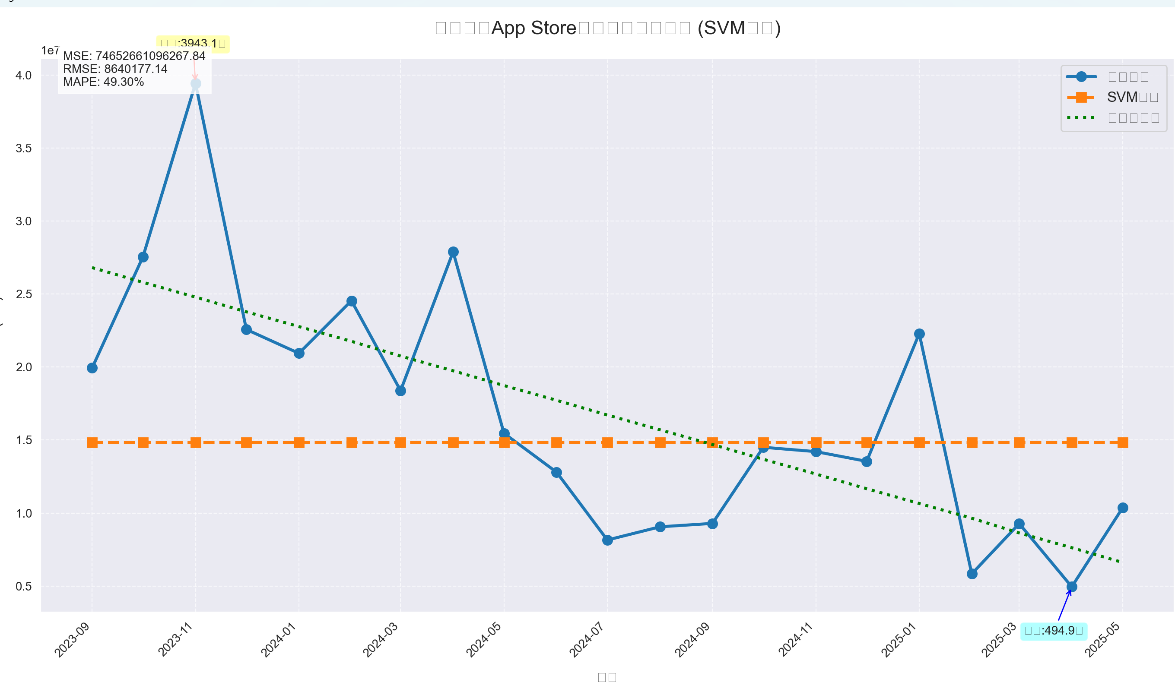
Use SVM for financial prediction.
SVM

Slide 13
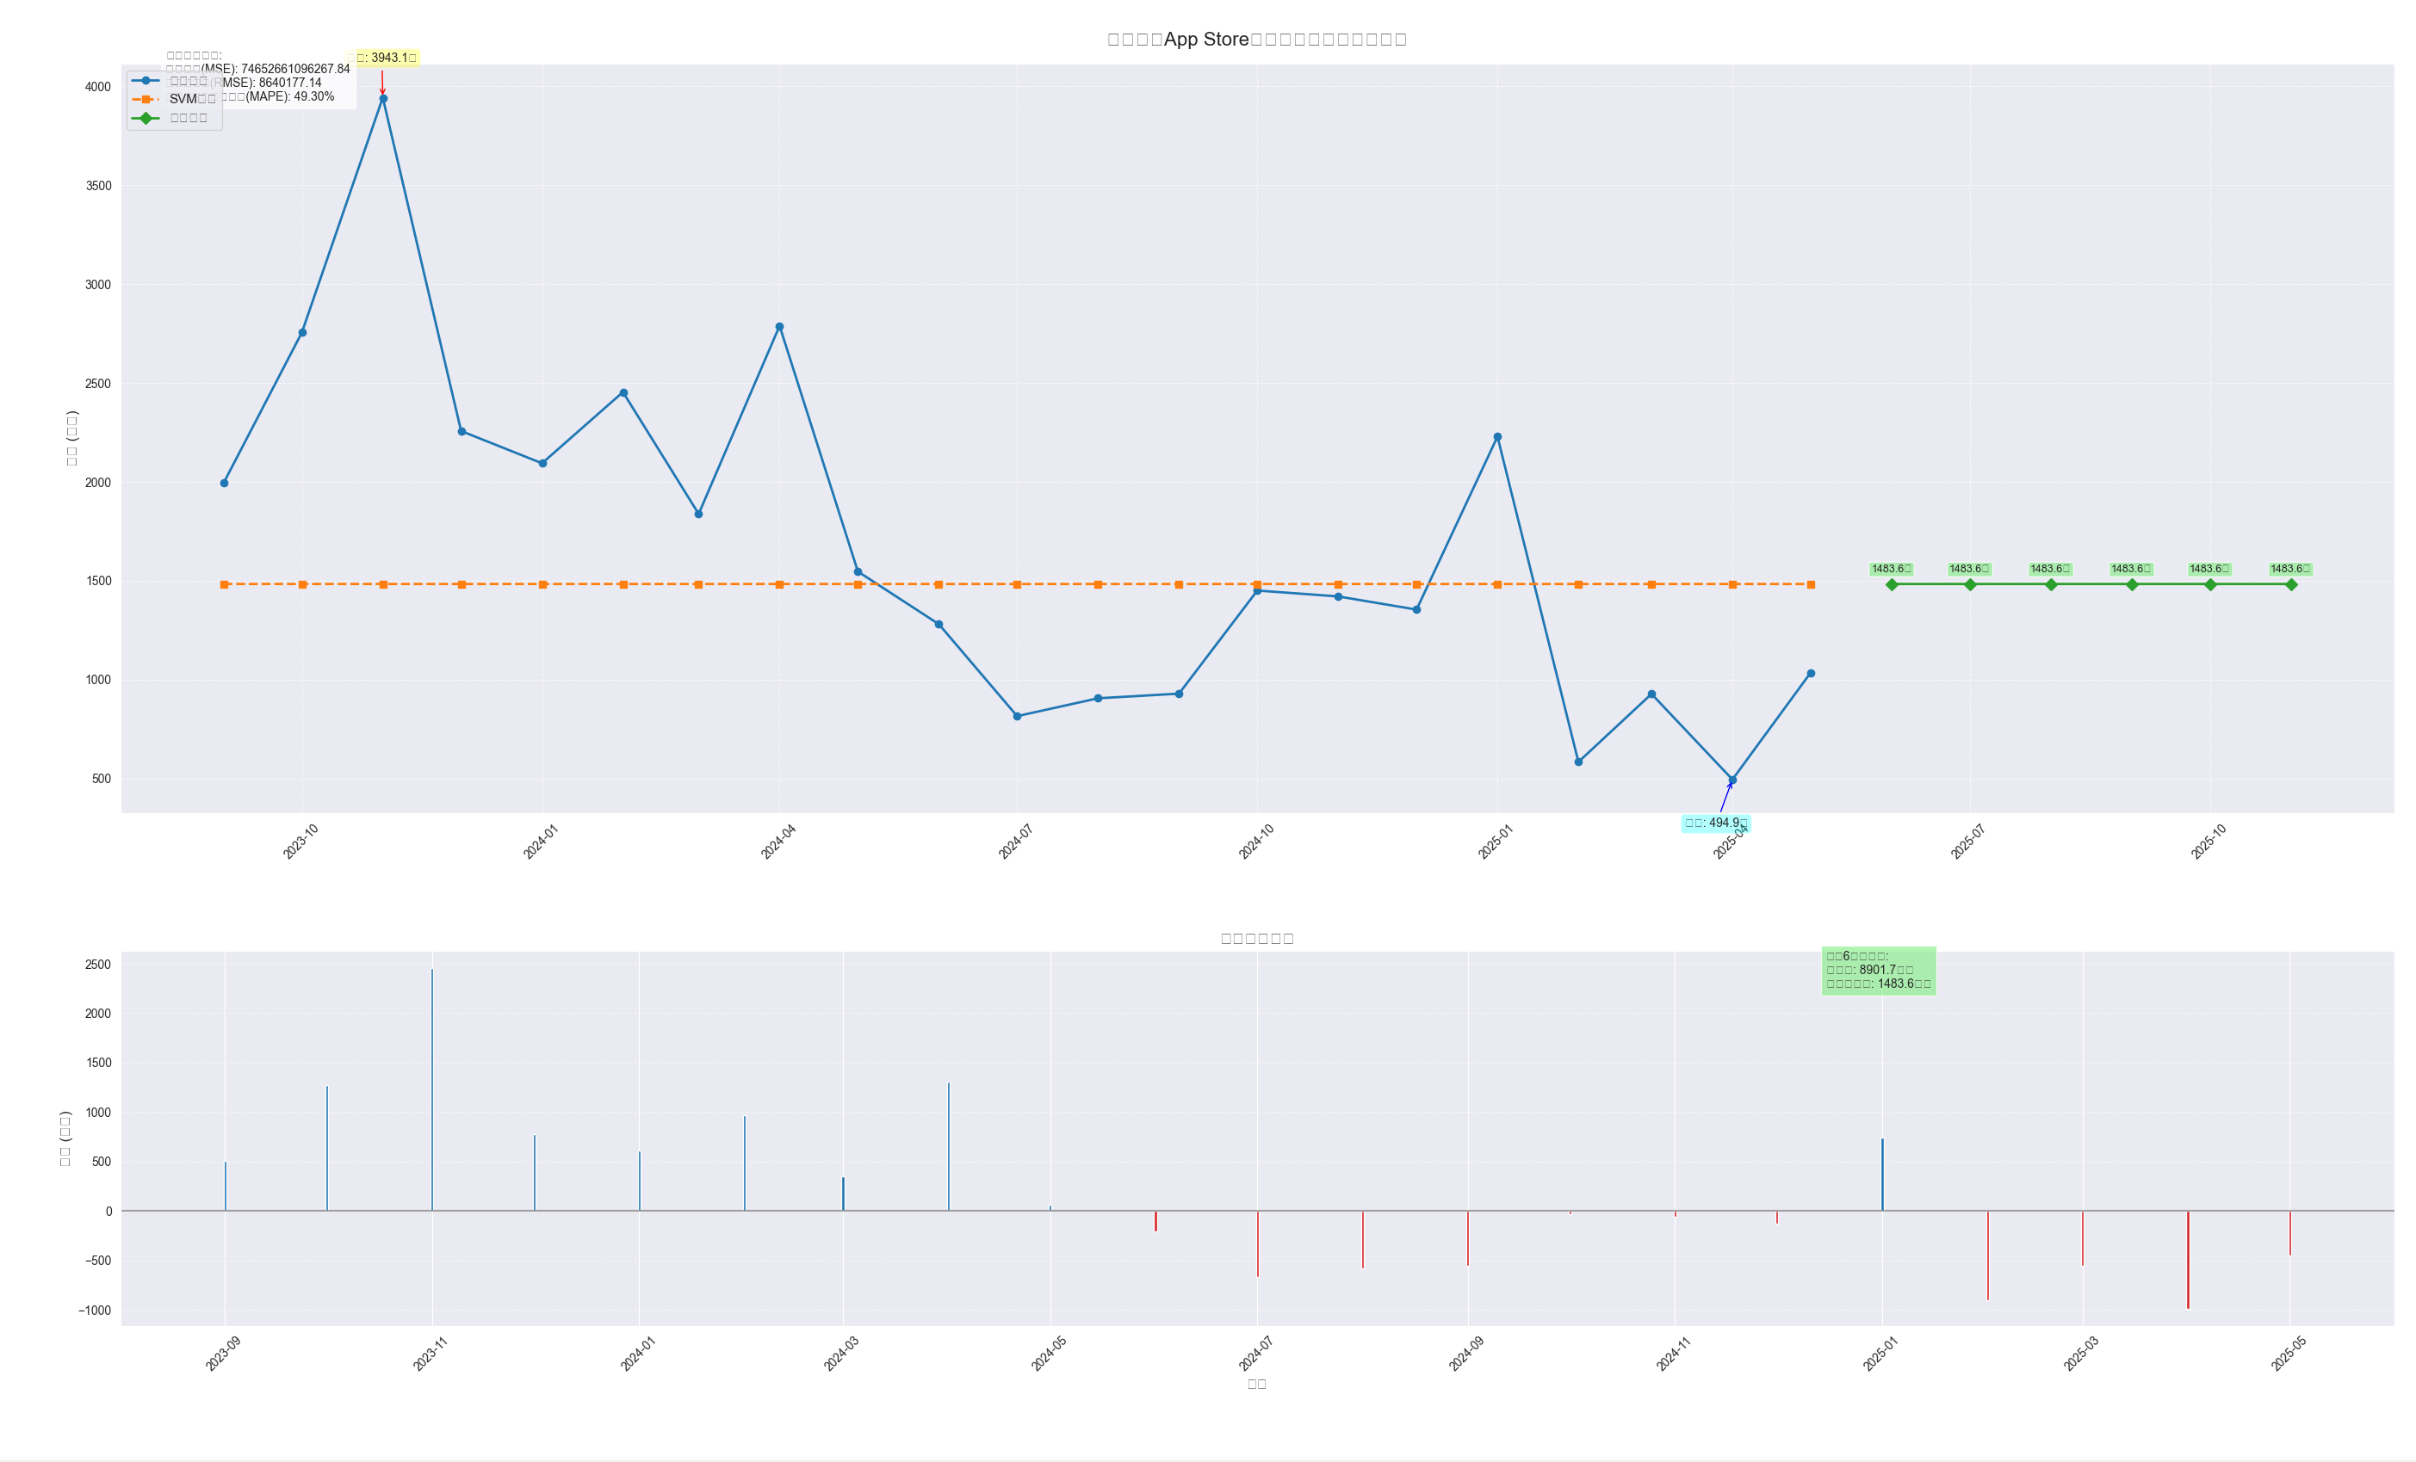
Predictions
Predictive Modeling

Slide 14
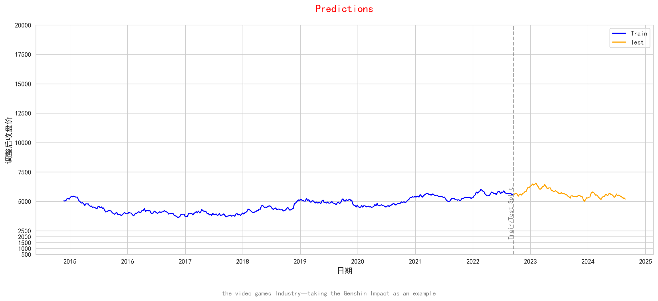
Predictions
Predictive Modeling
Setting
Train and test data set
Method 1: Linear Regression
Method 2: Machine Learning
Support Vector Machine
Though the prediction results are not that good, we can still learn valuable insights from the analysis.

Slide 15
Conclusions
Conclusions
1. Cultural and economic importance of video games industry
Word cloud and LDA textual analysis
2. Visualization of stock price and return in video games industy
Word cloud and LDA textual analysis
3. Dimensionality reduction of prices, clustering of daily return series, and correlation among income
UMAP, MST
4. Prediction of Guizhou Maotai stock price
Machine learning, SVM

